Slide 1
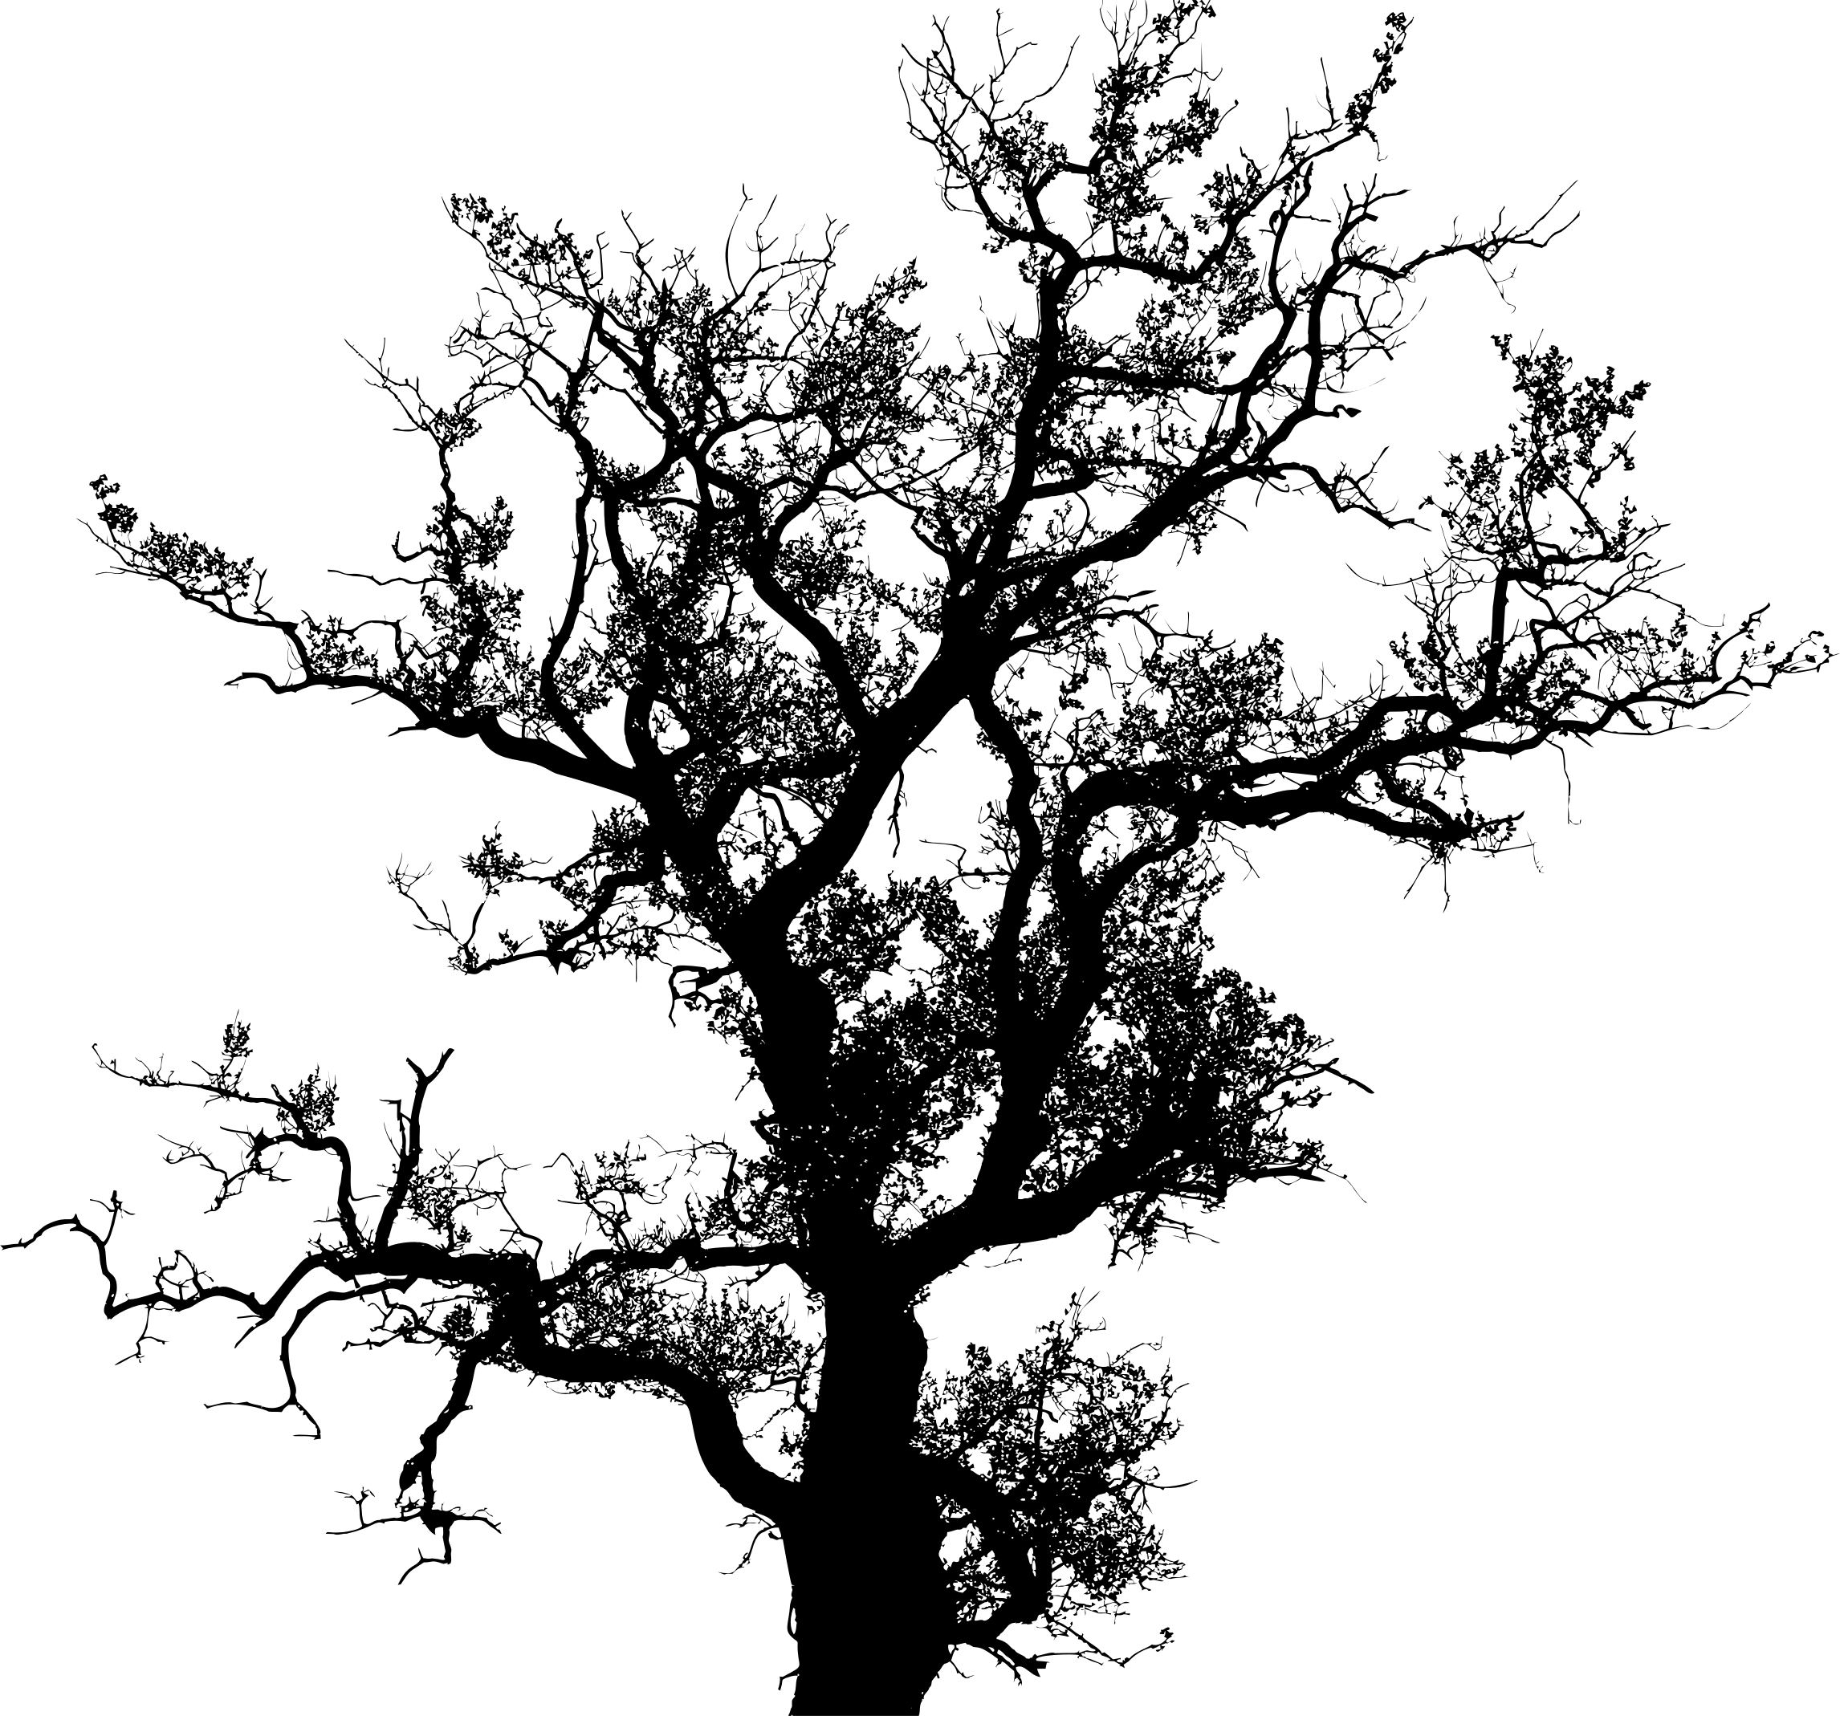
Decision Trees
Supervised Machine Learning with Decision Trees

Slide 2


Decision Trees
Does this human earn more than $128.12?
Banks can't blindly trust the machine answer.
What if there's a system failure, hacker attack or a quick fix from a senior?
To deal with it, we have Decision Trees.
All the data automatically divided to yes/no questions.
They could sound a bit weird from a human perspective, e.g., whether the creditor earns more than $128.12?
Though, the machine comes up with such questions to split the data best at each step.

Slide 3
Decision Trees
Who is the mother of father of the niece of the brother of the nephew of the son of the insurer?
That's how a tree is made.
The higher the branch — the broader the question.
Any analyst can take it and explain afterwards. He may not understand it, but explain easily! (typical analysts)
Decision trees are widely used in high responsibility spheres:
Diagnostics
Medicine
Finances

Slide 4


Decision Trees
The two most popular algorithms for forming the trees are CART and C4.5.
Pure decision trees are rarely used today.
However, they often set the basis for large systems, and their ensembles even work better than neural networks.
When you google something, that's precisely the bunch of dumb trees which are looking for a range of answers for you.
Search engines love them because they're fast.

Slide 5
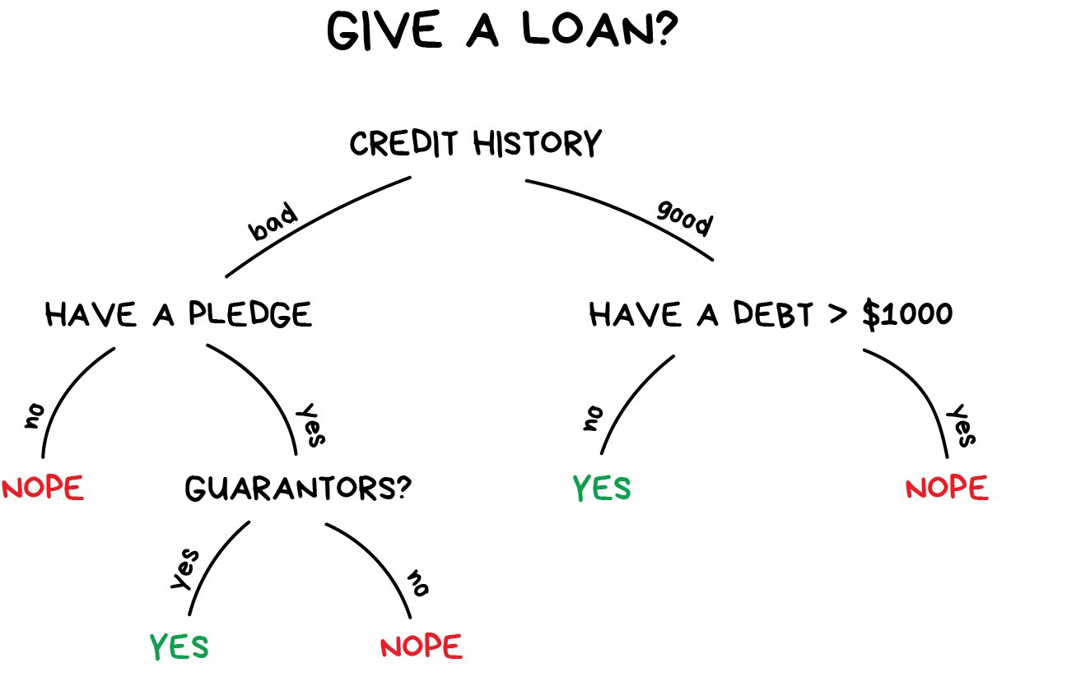
Decision Trees

Slide 6
The CART Algorithm
Data
Test
Train
Test
Train
Test
Train
Test
Train
Test
Train
Test
Train
Test
Train

Slide 7
The CART Algorithm
Scikit-Learn uses the Classification And Regression Tree (CART) algorithm to train Decision Trees (also called “growing” trees).
The idea is really quite simple: the algorithm first splits the training set in two subsets using a single feature k and a threshold t_{k}
Once it has successfully split the training set in two, it splits the subsets using the same logic, then the sub-subsets and so on, recursively.
CART algorithm is a greedy algorithm: it greedily searches for an optimum split at the top level, then repeats the process at each level.
It does not check whether or not the split will lead to the lowest possible impurity several levels down.

Slide 8
Important Terminology related to Decision Trees
Root Node: It represents entire population or sample and this further gets divided into two or more homogeneous sets.
Splitting: It is a process of dividing a node into two or more sub-nodes.
Decision Node: When a sub-node splits into further sub-nodes, then it is called decision node.
Leaf/ Terminal Node: Nodes do not split is called Leaf or Terminal node.
Pruning: When we remove sub-nodes of a decision node, this process is called pruning. You can say opposite process of splitting.
Branch / Sub-Tree: A sub section of entire tree is called branch or sub-tree.
Parent and Child Node: A node, which is divided into sub-nodes is called parent node of sub-nodes where as sub-nodes are the child of parent node.

Slide 9
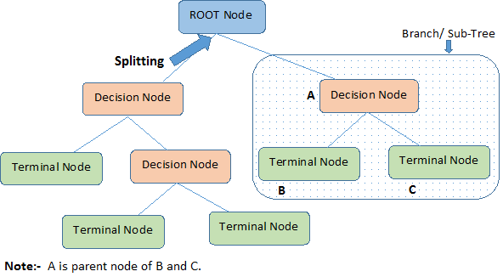
Decision Trees

Slide 10
Pruning
The technique of setting constraint is a greedy-approach.
The algorithm will check for the best split instantaneously and move forward until one of the specified stopping condition is reached.

Slide 11
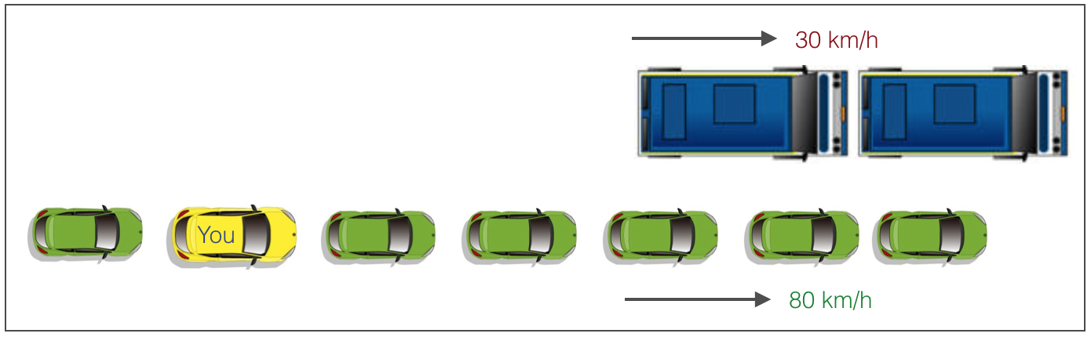
Pruning
Consider the following case when you’re driving:

Slide 12
Pruning
There are 2 lanes:
A lane with cars moving at 80km/h
A lane with trucks moving at 30km/h
At this instant, you are the yellow car and you have 2 choices:
Take a left and overtake the other 2 cars quickly
Keep moving in the present lane

Slide 13
Pruning
Lets analyze these choices.
In the former choice, you’ll immediately overtake the car ahead and reach behind the truck and start moving at 30 km/h, looking for an opportunity to move back right.
All cars originally behind you move ahead in the meanwhile.

Slide 14
Pruning
This would be the optimum choice if your objective is to maximize the distance covered in next say 10 seconds.
In the later choice, you sale through at same speed, cross trucks and then overtake maybe depending on situation ahead. Greedy you!
This is exactly the difference between normal decision tree & pruning.
A decision tree with constraints won’t see the truck ahead and adopt a greedy approach by taking a left.
On the other hand if we use pruning, we in effect look at a few steps ahead and make a choice.

Slide 15
Advantages
Easy to Understand
Decision tree output is very easy to understand even for people from non-analytical background.
It does not require any statistical knowledge to read and interpret them.
Its graphical representation is very intuitive and users can easily relate their hypothesis.

Slide 16
Advantages
Useful in Data exploration
Decision tree is one of the fastest way to identify most significant variables and relation between two or more variables.
With the help of decision trees, we can create new variables / features that has better power to predict target variable.
It can also be used in data exploration stage. For example, we are working on a problem where we have information available in hundreds of variables, there decision tree will help to identify most significant variable.

Slide 17
Advantages
Less data cleaning required
It requires less data cleaning compared to some other modeling techniques.
It is not influenced by outliers and missing values to a fair degree.

Slide 18
Advantages
Data type is not a constraint
It can handle both numerical and categorical variables.
Non Parametric Method
Decision tree is considered to be a non-parametric method.
This means that decision trees have no assumptions about the space distribution and the classifier structure.

Slide 19
Disadvantages
Over fitting
Over fitting is one of the most practical difficulty for decision tree models.
This problem gets solved by setting constraints on model parameters and pruning

Slide 20
Disadvantages
Not fit for continuous variables
While working with continuous numerical variables, decision tree looses information when it categorizes variables in different categories.

Slide 21
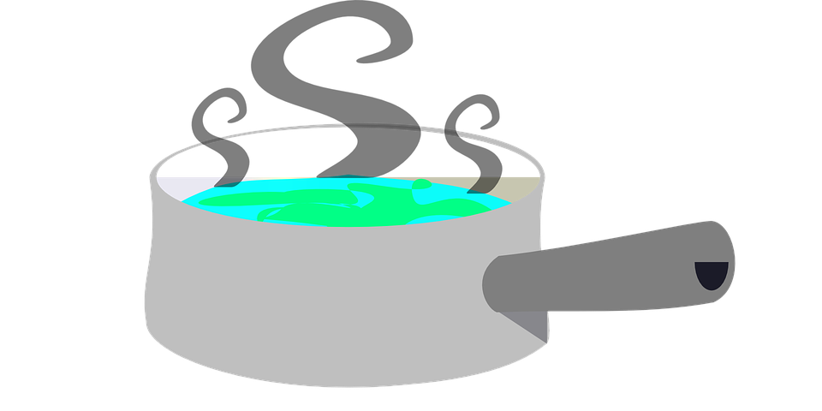
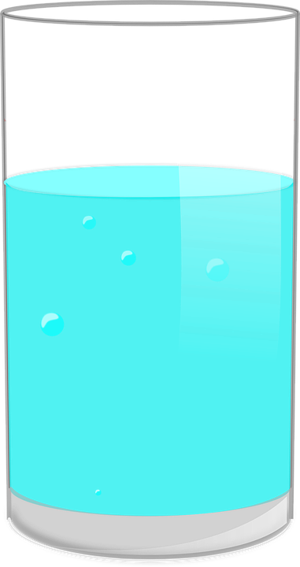
Entropy
The concept of entropy originated in thermodynamics as a measure of molecular disorder.
Entropy approaches zero when molecules are still and well ordered.
In Machine Learning, it is frequently used as an impurity measure.
A set’s entropy is zero when it contains instances of only one class.
The more it is closer to zero, the better your algorithm.
Entropy ~ 0
Entropy = dQ/T

Slide 22
Gini Index
We use the Gini Index as our cost function used to evaluate splits in the dataset.
A Gini score gives an idea of how good a split is by how mixed the classes are in the two groups created by the split.
A perfect separation results in a Gini score of 0,
The worst case split that results in 1.
CART (Classification and Regression Tree) uses Gini method to create binary splits.

Slide 23
Metric | What does it say? | What it should be?
Accuracy | Proportion of the correctly classified samples and all the samples. | Closer to 1, the better
Precision & Recall | Actual probability and Predicted probability | Closer to 1, the better
F1 Score | Harmonic Mean of Precision and Recall | Closer to 1, the better
Confusion Matrix | Identify a class that’s constantly mistaken for some other class. | If the classifier is perfect, you’ll obtain non-zero values only on the main diagonal.
Performance Metrics

Slide 24
Metric | What does it say? | What it should be?
Receiver Operating Characteristic (ROC) Curve | Probability curve | Closer to 1, the better
Area Under ROC Curve (AOC) | How much the model is capable of distinguishing between classes | Closer to 1, the better
Performance Metrics

Slide 25
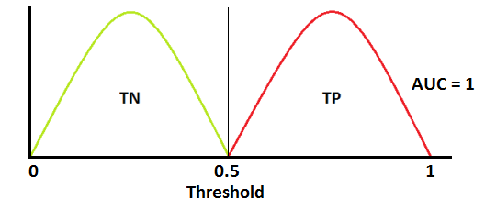
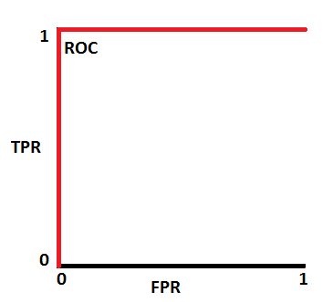
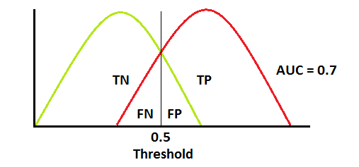
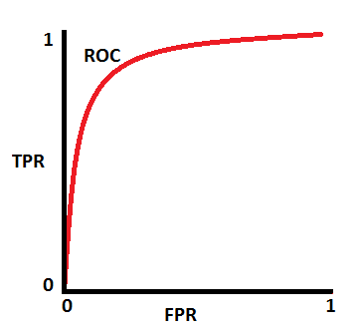
AUC and ROC Curve

Slide 26
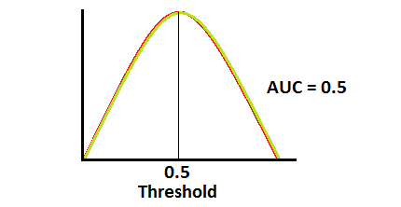
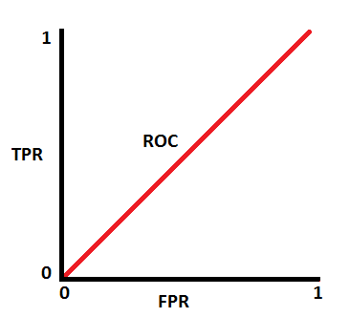
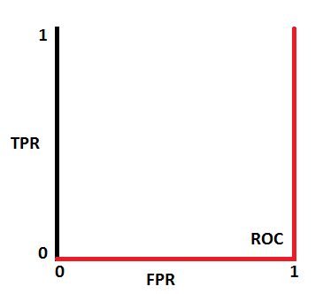
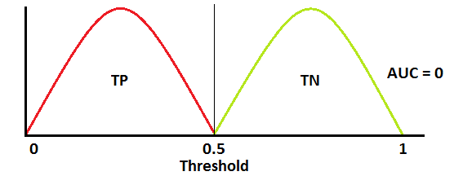
AUC and ROC Curve

